Slide 1

Credit Card Default Prediction Using Machine Learning
CS 677 Final Project – Presentation | December 18, 2025 | Fnu Ashutosh (U01955320), Atharva Pande (U01985210), Kenji Okura (U01769019)
Notes:
Introduce ourselves

Slide 2


PROBLEM STATEMENT
Problem
Statement: Predict whether a credit card customer will default on their next payment, which enables proactive risk management and minimizing financial losses.
WHY? – THE BUSINESS IMPACT
Accurate predictions are needed to minimize financial loss for the credit card company. On average:
Not predicting a default (false negative) costs $10,000 per customer
Incorrectly predicting a default (false positive) can cost $200 per customer
Class imbalance is 77.88 non-default to 22.12 default (3.52:1 ratio).
Because of the high cost of defaults, recall (or catching the defaults) a critical metrics.
The model would need to prioritize catching true defaulters, while trying to minimize the chances of false positives. All to maximize profits.
Notes:
[ read the problem statement ]
Credit card default prediction is a critical risk management challenge for financial institutions. In 2024, consumer credit card debt in the United States exceeded $1.08 trillion, with default rates averaging 3-4% annually. The industry loses 30-40 billion annually due defaulting.

Slide 3
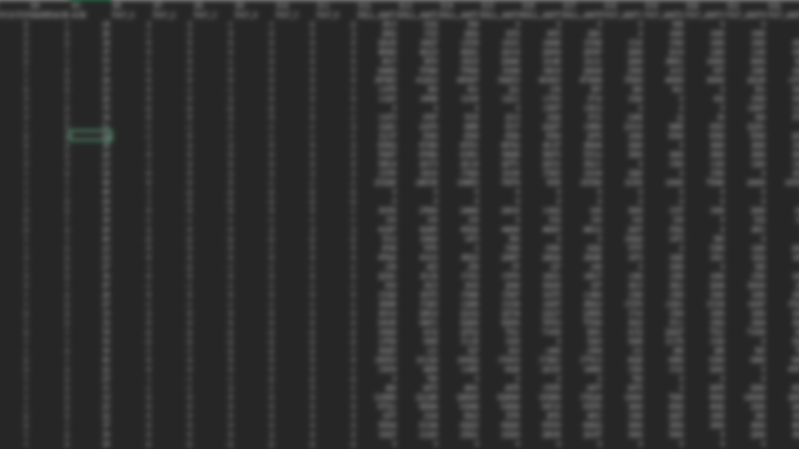

Dataset
dataset
UC Irvine’s Machine Learning Repository - Default of Credit Card Clients
Quick Stats
Sample Size: 30,000 customers
Training – test split: 80-20 (24,000 training, 6,000 test samples).
Time period: April 2005 – September 2005 (6 months)
Number of features: 23
All do not have null values (no missing data!)
All are integer data types
Example include sex, limit_bal, education, payment status, etc.
The target variable (if they defaulted next month) is binary (0 or 1).
Why this dataset?
Real-world relevance with a sufficient size and many features. The default rate balance of 22.12 reflects realw work distributions.
Notes:
The dataset comes from a major Taiwanese financial institution.
The features include demographics, payment status, bill amount, and payment amount.

Slide 4

PROJECT OVERVIEW
eda
Feature engineering
Analysis and insights gained through preforming the Exploratory Data Analysis
Transforming raw variables to predictive features that capture more domain knowledge
Model Development
Evaluate & Model comparison
Discuss models we created
Test and compare which model works best
Hyperparameter tuning & impact
Improve models
Please NOTE: Some sections of req. Document covered as subsections of above.
Notes:
Kenji

Slide 5

Exploratory Data Analysis (EDA) The Dataset Structure, Basic Information, Statistics, and quick analysis
Missing Data
The source of data indicated there is no missing data. Analysis agreed with this.
Shape and Size
Data Types
Stats
30,000 samples
23 features
Totals to 690,000 data points
The features are all integers
The target is a binary 0 or 1
Together they take 5.3 mb of space
We calculate the mean, standard deviation, min max etc. Some insights are:
- Credit Limit Range: NT$10,000 - NT$1,000,000
• Average Credit Limit: NT$167,484
• Age Range: 21 - 79 years
• Average Age: 35.5 years
Duplicate Data
There are 35 duplicate data.
Outliers
We tested outliers on select features (like age). We discover that LIMIT_BAL is most effected.
Notes:
Kenji

Slide 6
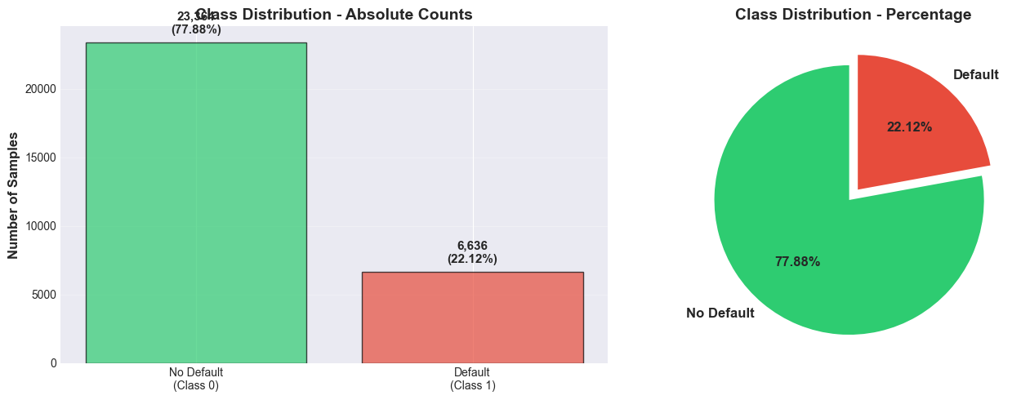
Exploratory Data Analysis (EDA) Target Variable Distribution
Class Distribution
Why?
To apply correct evaluation metrics, decide on sampling strategies or setting realistic expectation
What we learned?
Moderately imbalanced, meaning class aware techniques is needed.
More than just testing for accuracy is needed.
Notes:
“1 defaulter, there are 3.5 non-defaulter”
Kenji

Slide 7
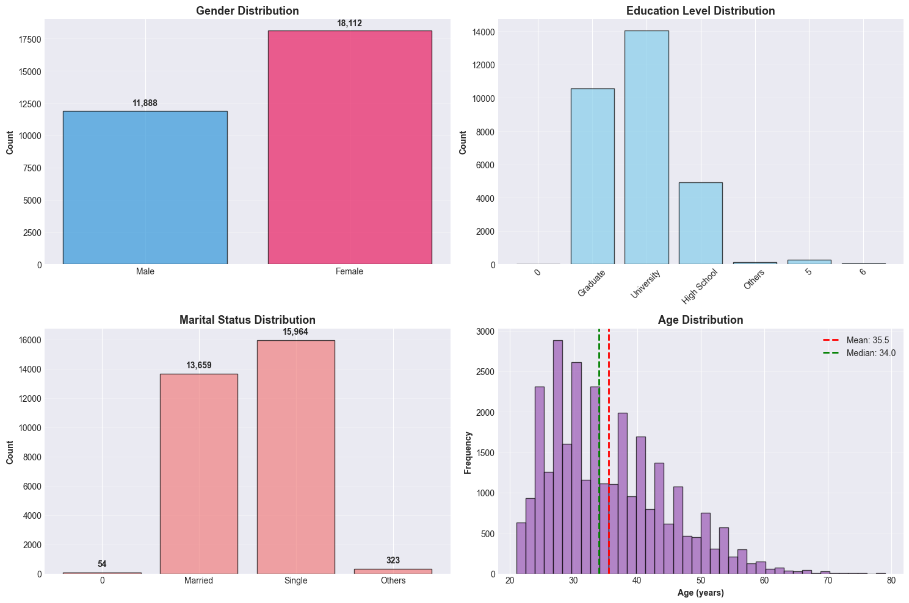
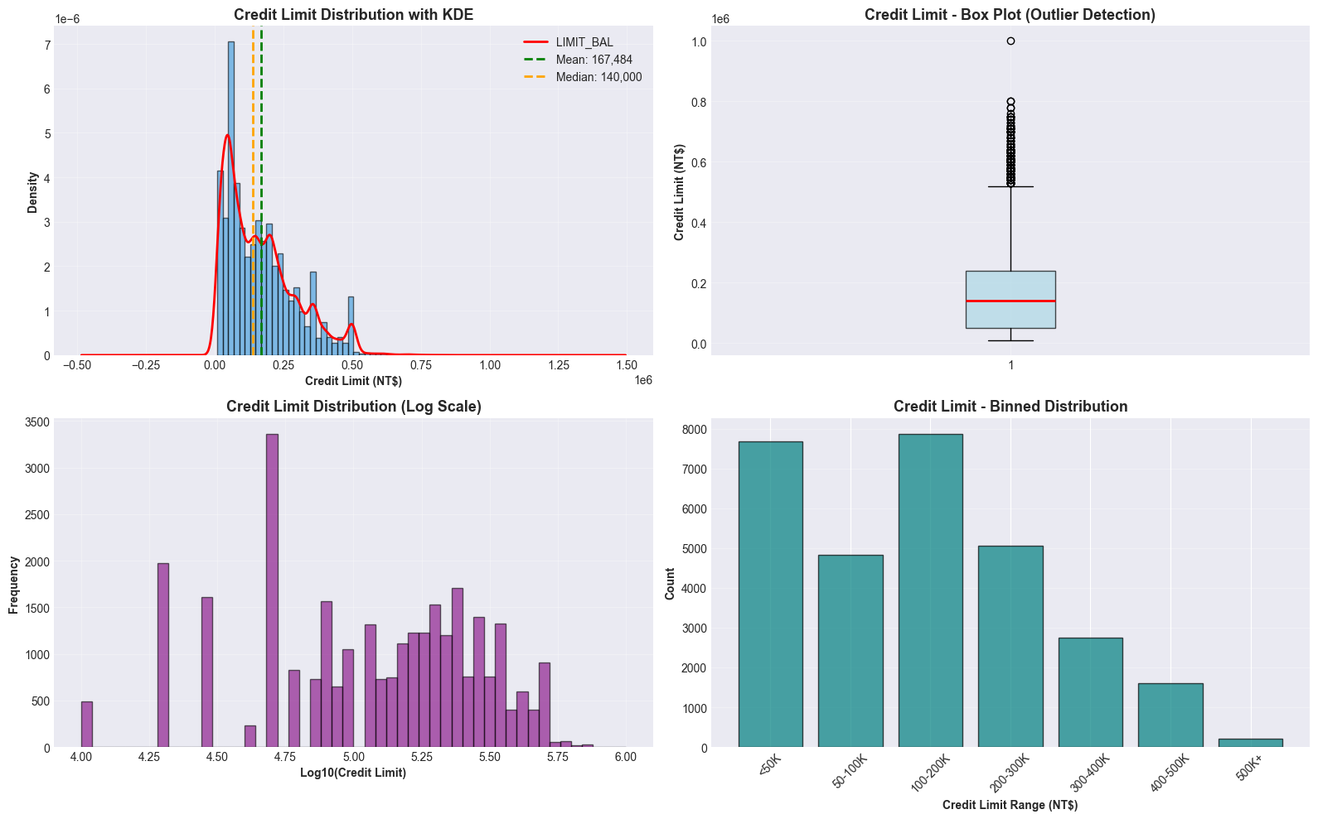
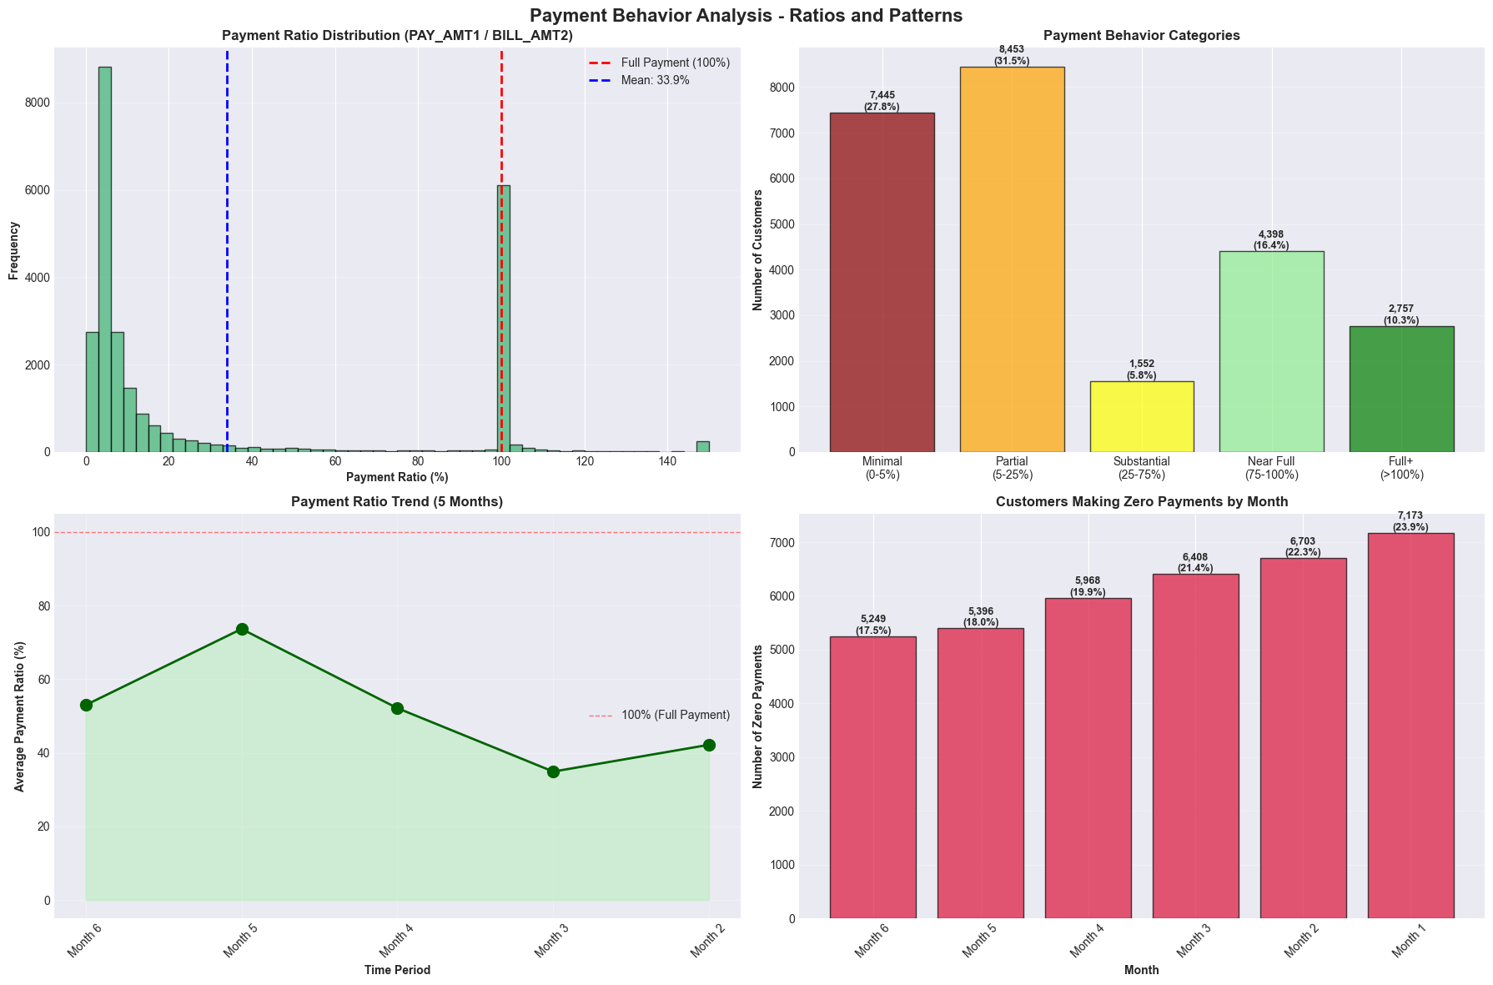
Exploratory Data Analysis (EDA) Analysis on Features
Demographic Features
Credit Limit Analysis
Payment Status
Bill Amount
Ex. Sex, education. marriage status, age.
For this case we calculated ratios of them for example.
Ex. LIMIT_BAL
Find distribution, patterns or outliers
Ex. PAY_0….PAY_6
When analyzed with theme, we learn that payment behavior is improving
Ex. BILL_AMT1
…. BILL_AMT6
Learned insights like high utilization is a strong default risk indicator
Payment Status
Ex. PAY_AMT1 to PAY_AMT6
Notes:
Kenji

Slide 8
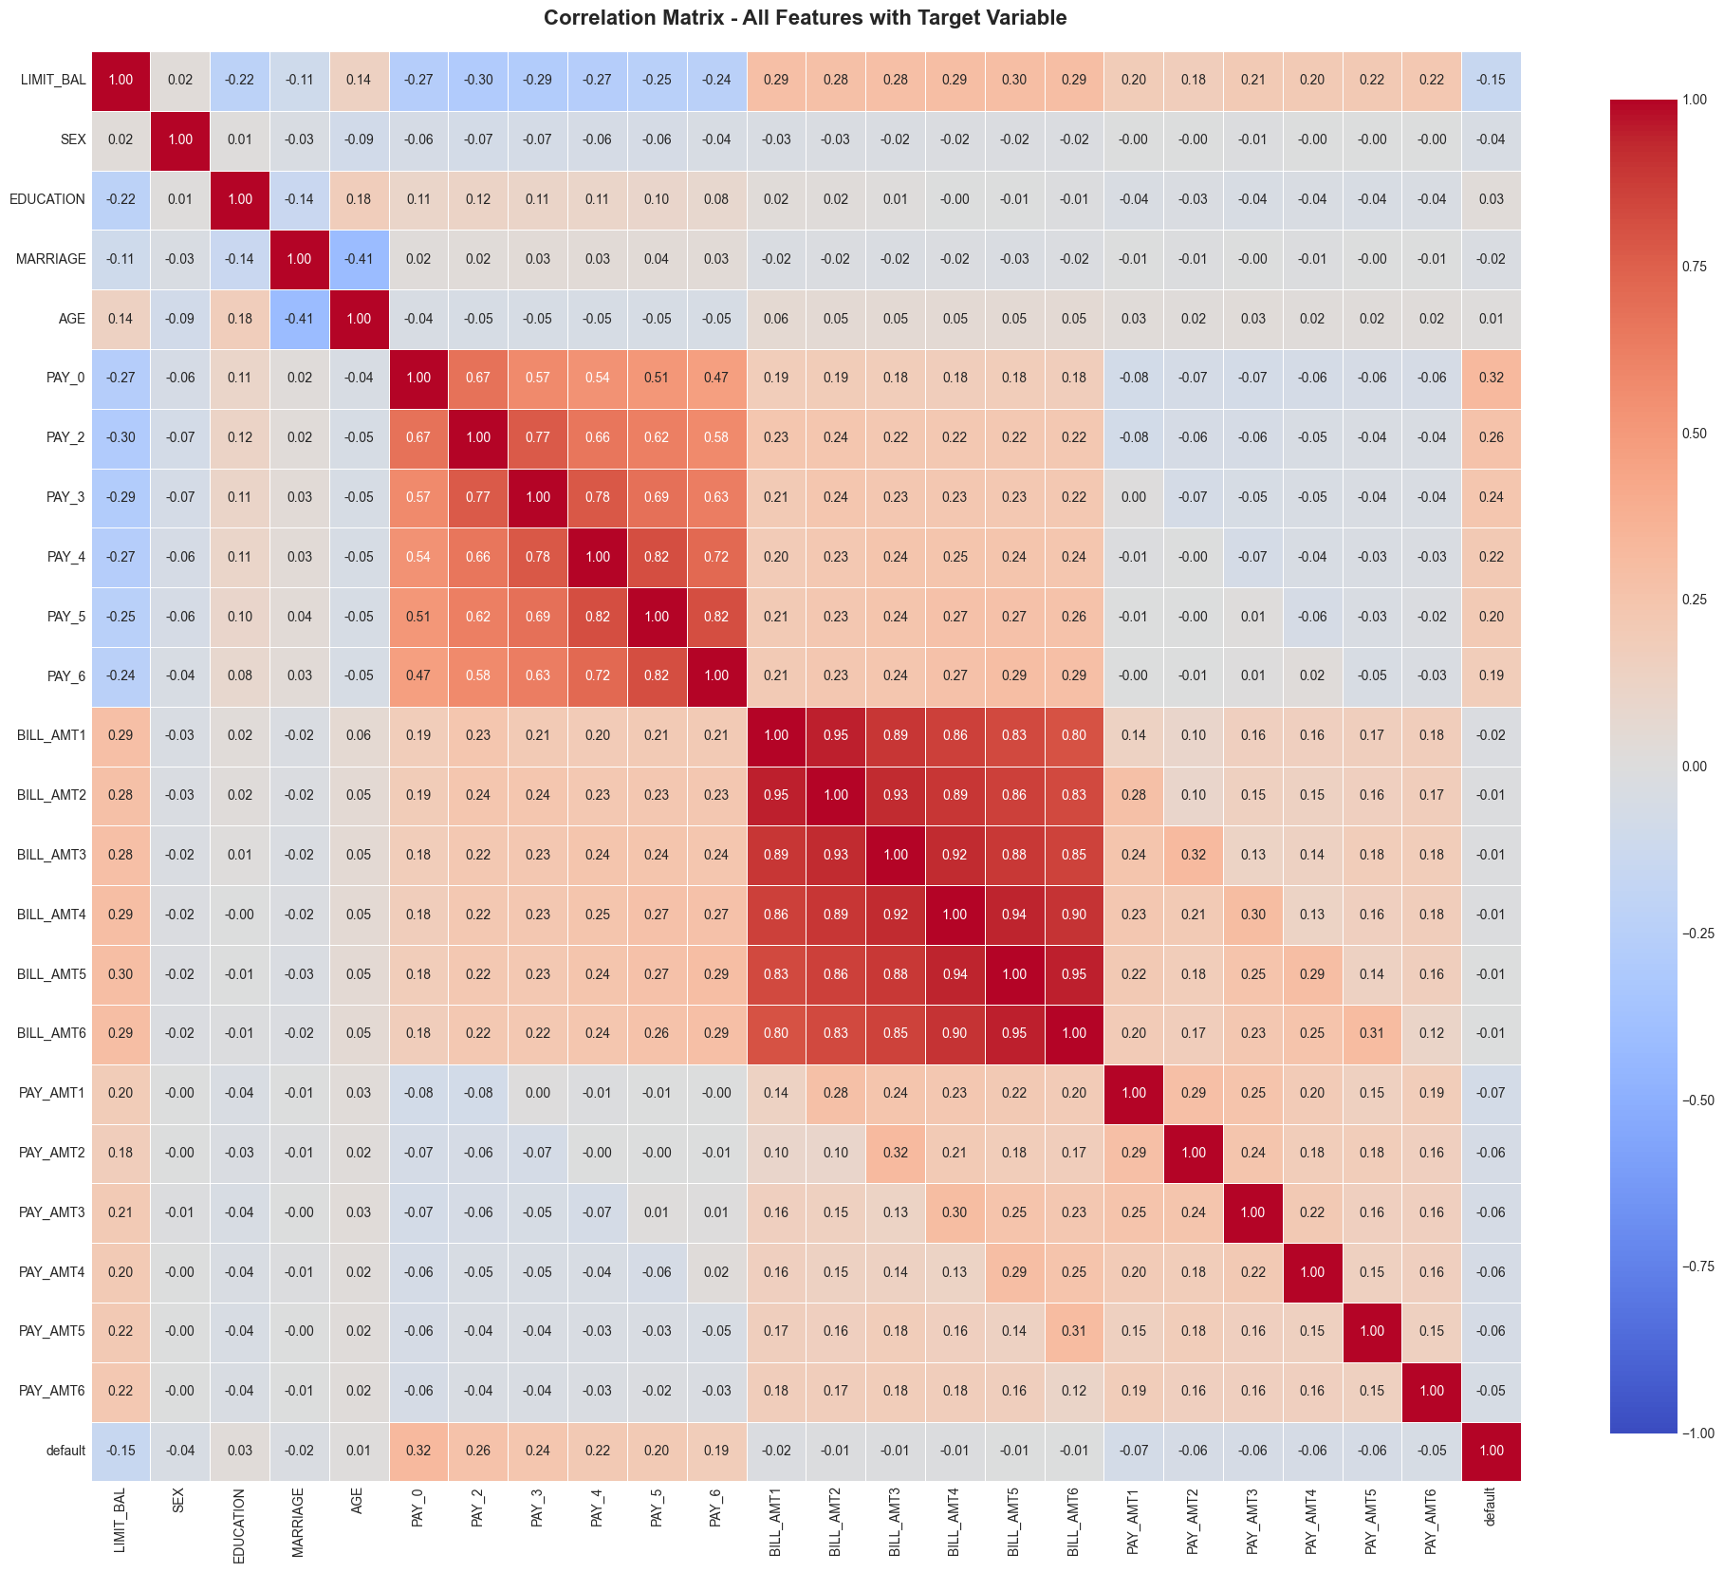
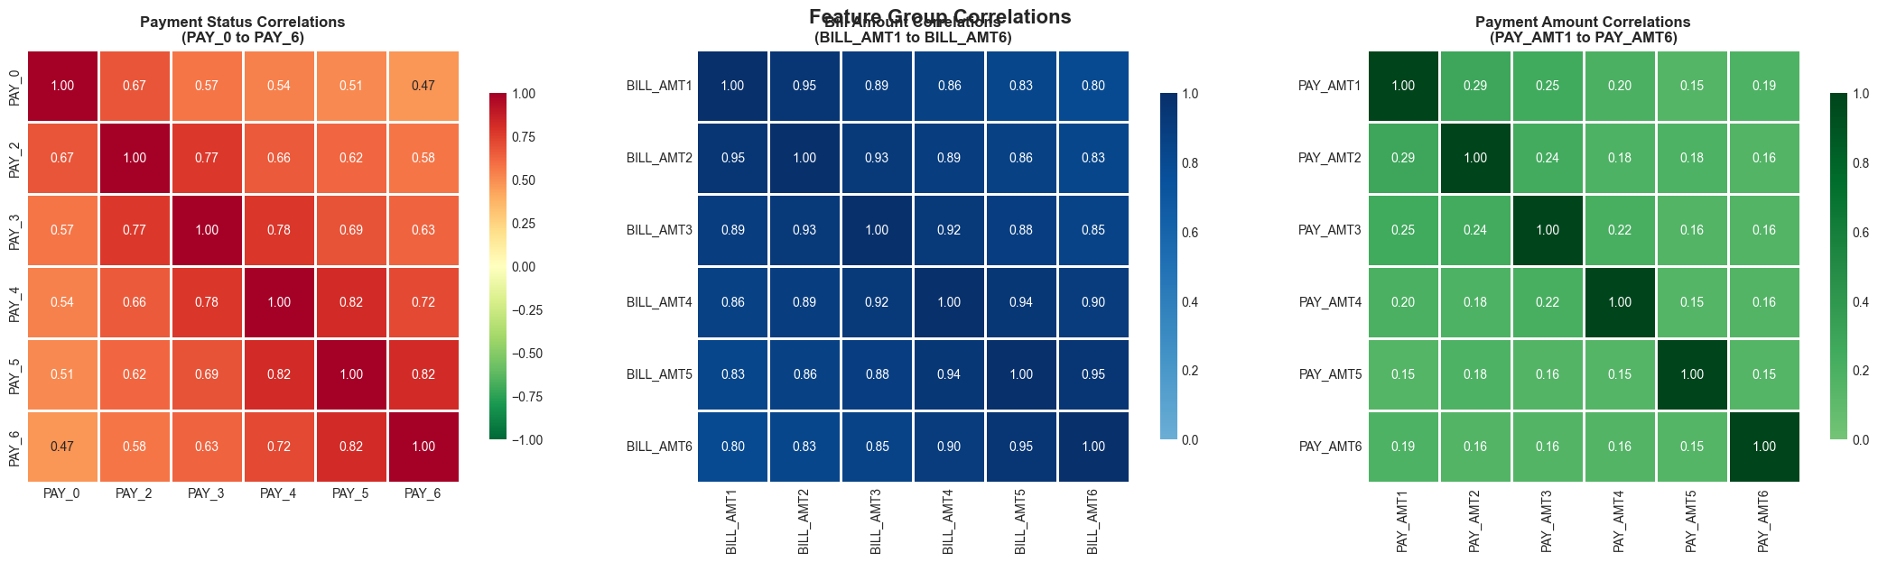
Exploratory Data Analysis (EDA) Correlation Analysis
Lessons Learned
We see high correlations for pay features, and demographics.
Once the grand correlation analysis we selected the highest correlations to compare the correlations.
See below.
Notes:
Kenji

Slide 9
Exploratory Data Analysis (EDA) Key Findings
SUMMARY
The dataset is clean and ready for modeling .
We do need to keep in mind we need to use techniques like class weightings and focus on Recall and F-1 score, not just accuracy
The most important predictors are payment status and credit utilization, not demographics.
The class imbalance and temporal nature of the data require special handling in modeling and feature engineering.
Notes:
Kenji

Slide 10

FEATURE ENGINEERING

Slide 11
Feature Engineering Our Focus & Features
Our Focus
High Level Features
Based on our EDA insights, we engineered features focusing on:
Credit utilization patterns (strong predictor of default)
Payment behavior consistency (PAY features = top predictors)
Temporal trends (bill/payment trajectories)
Risk indicators (late payments, underpayment patterns)
Credit Utilization Features (3 features, i.e. average utilization across 6 months)
Payment Fraction Features (3 features)
Payment Behavior Features (2 features)
Temporal Trend Features (3 features)
Repayment Status Features (3 features)
Bill Stability Features (2 features)
Payment Consistency Features (2 features)
Risk Indicator Features (3 features)
Demographic Interaction Features (4 features, ex. Education-repayment )
We created 23 new features and verified they aren’t missing values or infinite values.
Notes:
Kenji

Slide 12
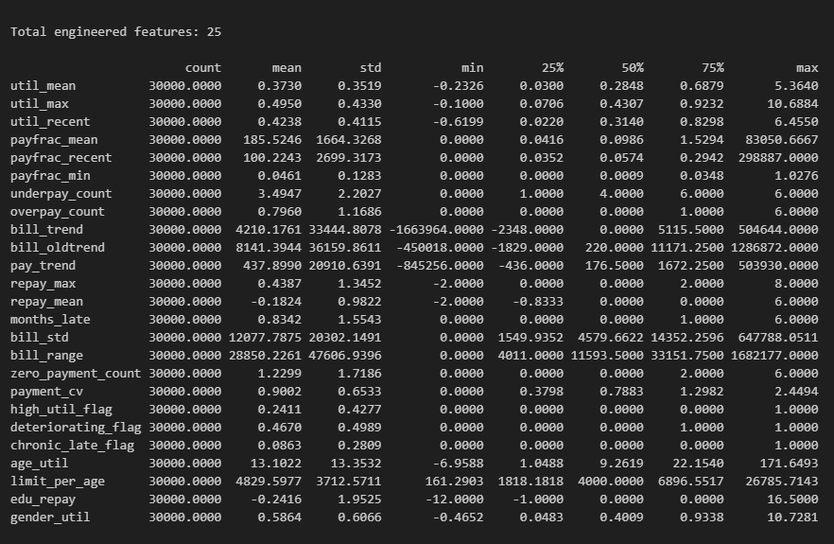
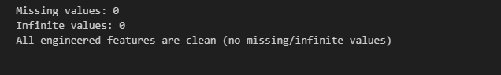
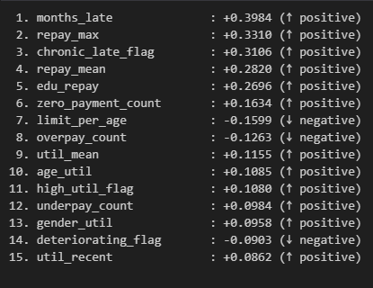
EDA Engineered Features

Slide 13
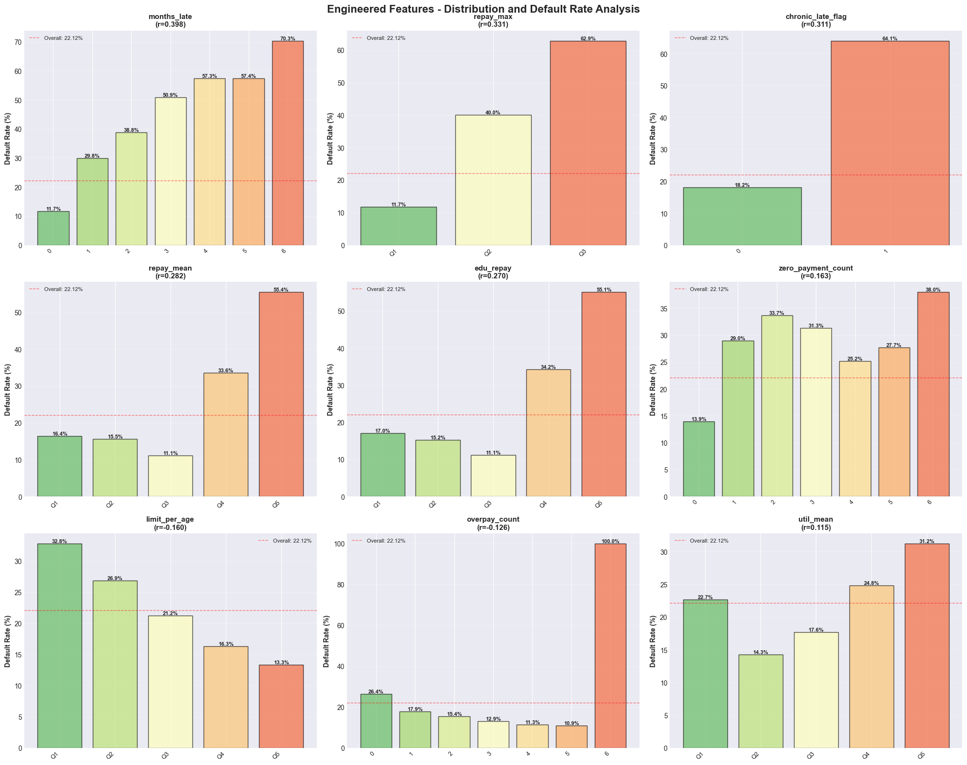
Feature Engineering Insights
General Insights
Data Viz Insights
Top 3 engineered features by correlation with default:
months_late (count of months with late pay)
repay_max (max pay delay)
chronic_late_flag (>3 months late)
Observation (not just with top 3):
Utilization and repayment features show strongest correlations
Temporal trends capture payment behavior changes
Risk flags effectively identify high-risk patterns
Higher values in risk features correlate with higher default rates
Utilization features show clear risk gradients
Payment behavior features distinguish defaulters from non-defaulter
Notes:
Kenji

Slide 14

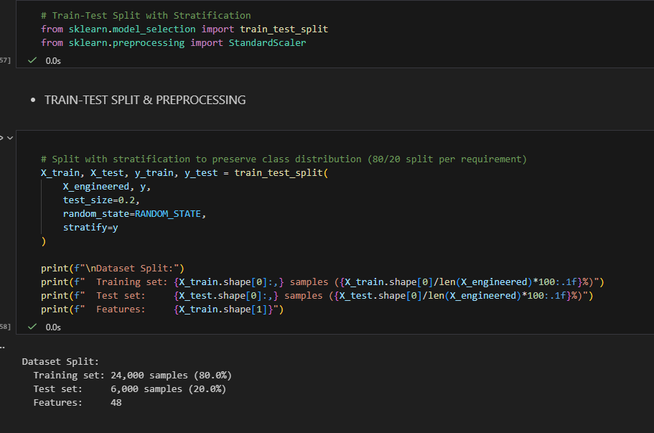
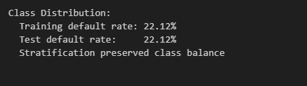
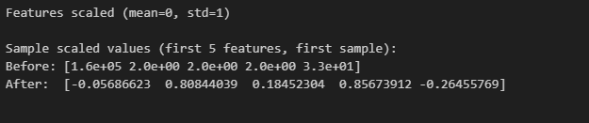
Data preparation for model training

Slide 15

MODEL DEVELOPMENT AND EVALUATION
Notes:
Ashu

Slide 16

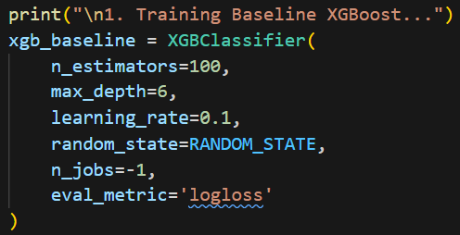
XGBoost Baseline
General Insights
Model 1: Standard XGBoost Baseline - optimized for accuracy.
Some stats!
Accuracy: 0.8183
Precision: 0.6591
Recall: 0.3700
F1-Score: 0.4739
AUC (Area Under the ROC Curve): 0.7779
Missed Defaults (FN): 836
False Alarms (FP): 254
Caught Defaults (TP): 491
True Negatives (TN): 4419
What is XGBoost?
XGBoost (aka eXtreme Gradient Boosting) uses gradient boosted decision trees (a learning algorithm that uses gradient descent) to reduce overfitting. XGBoost allows:
Parallelism – speed up!
Cache-awareness – speed up!
Regularization (hyperparameter tuning)
Notes:
Ashu

Slide 17
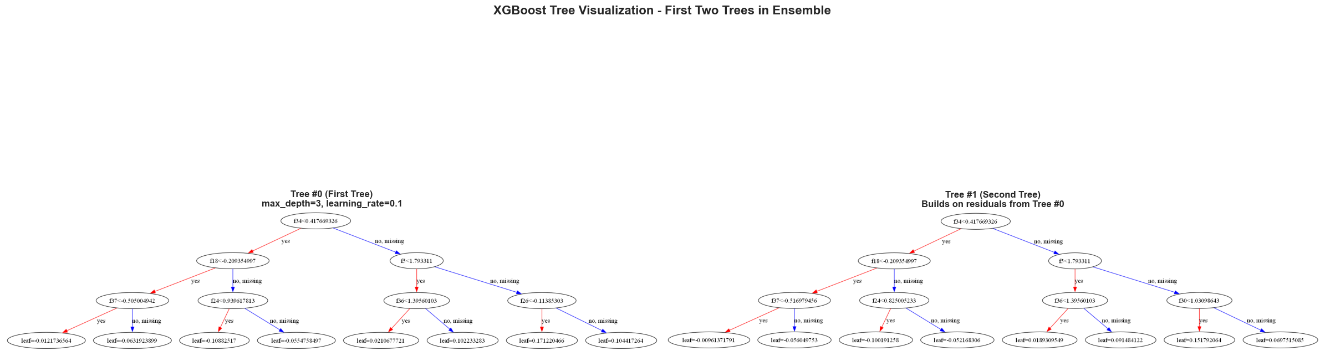
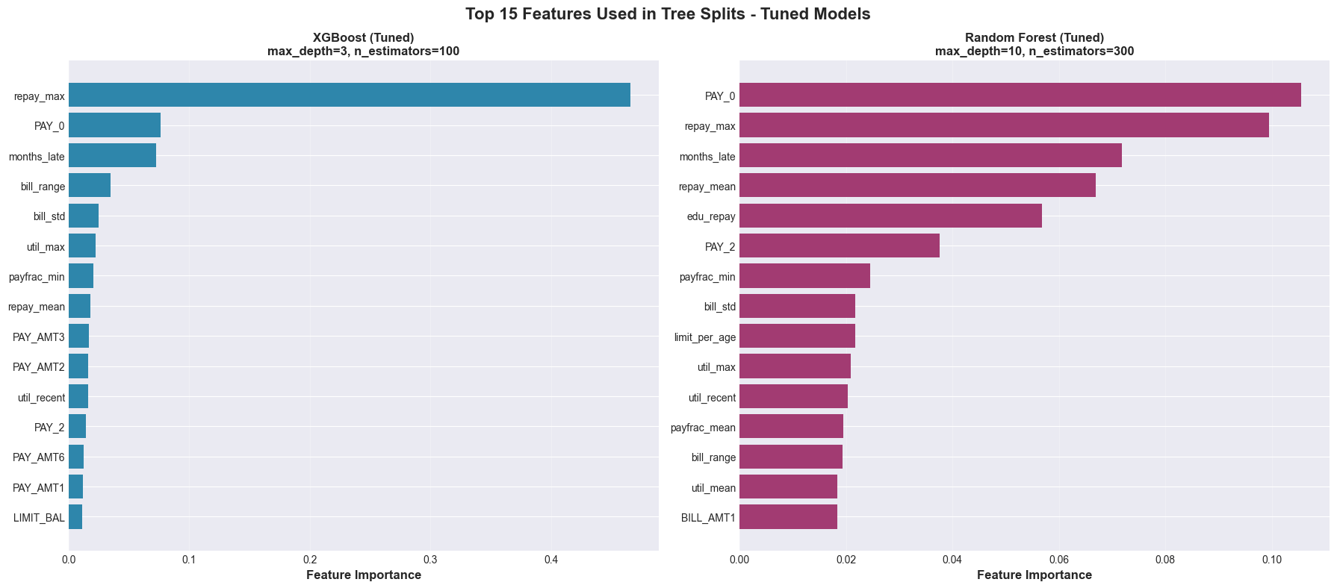
XGBoost Baseline – Hyperparameter Tuning and impact
Viz
- Max depth per tree: 3
- Each tree is learning from previous tree’s errors per the graph
- Leaf values represent contribution to final prediction
- Feature splits chosen to minimize loss function
General Insights
Parameters tuning was done on: max_depth, learning_rate, n_estimators, and scale_pos_weight.
GridSearchCV and XGBClassifier were used together
Accuracy: 0.7747 (from 0.81)
Precision: 0.4923 (from 0.65)
Recall: 0.6051 (from 0.37)
F1-Score: 0.5429 (from 0.47)
AUC: 0.7819 (from 0.77)
Most Important Features
We can analyze which features the decision trees use most for splitting decisions. For this model it’s:
repay_max, pay, etc.
Feature importance helps interpret what drives default prediction
Notes:
Ashu

Slide 18
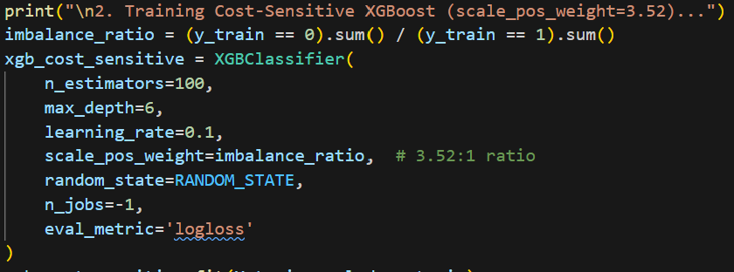
XGBoost Cost-Effective
Model 2: Cost-effective XGBoost – false negatives are penalized more heavily. To enable cost-sensitive XGBoost, a “scale_pos_weight” was added with a 3.52:1 ratio considering the in-balance of classes.
Accuracy: 0.7620
Precision: 0.4715
Recall: 0.6285
F1-Score: 0.5388
AUC (Area Under the ROC Curve): 0.7757
Missed Defaults (FN): 493
False Alarms (FP): 935
Caught Defaults (TP): 834
True Negatives (TN): 3738
Notes:
Ashu

Slide 19
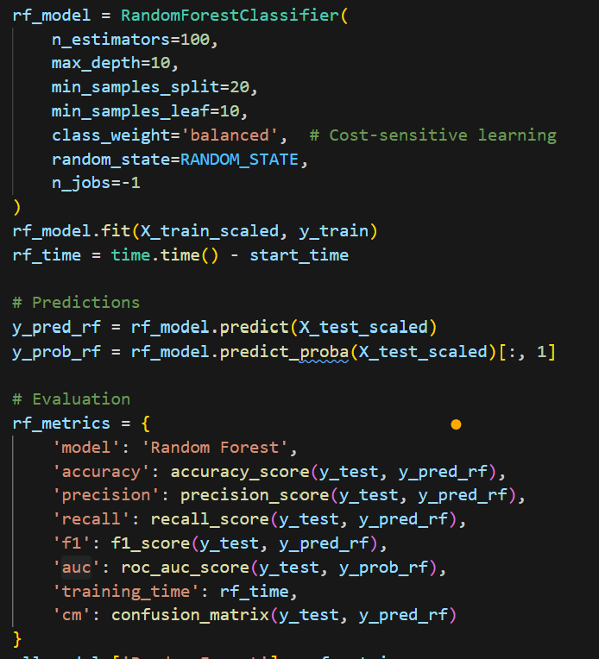
Random Forest Classifier
Model 3: Experiments with other models – Random Forest
Accuracy: 0.7758
Precision: 0.4943
Recall: 0.5923
F1-Score: 0.5389
AUC (Area Under the ROC Curve): 0.7802
Missed Defaults (FN): 541
False Alarms (FP): 804
Caught Defaults (TP): 786
True Negatives (TN): 3869
Notes:
Ashu

Slide 20
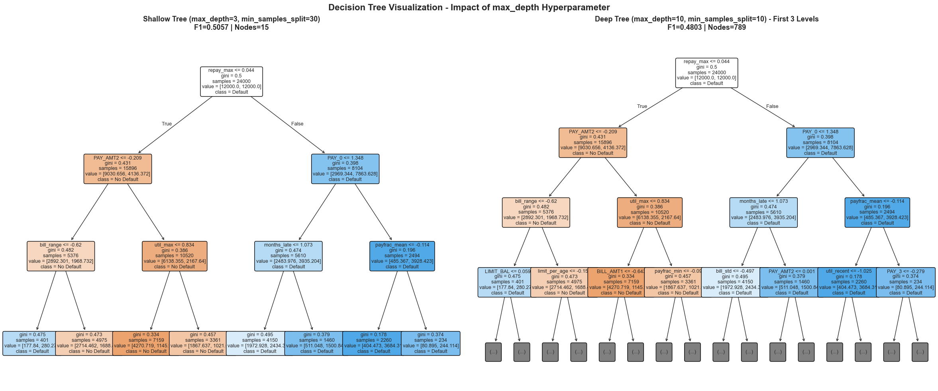
Random Forest Classifier – Hyperparameter tuning and impact
Viz
Shallow tree (less nodes) are simple but prevents over fitting
Deep tree is more complex but captures patterns
In this case shallow had better F1 score
General Insights
Parameters tuning was done on: n_estimators, max_depth, and min_samples_split
GridSearchCV and RandomForestClassifier were used together
Accuracy: 0.7792 (from 0.7758)
Precision: 0.5096 (from 0.4943)
Recall: 0.5885 (from 0.6923)
F1-Score: 0.5410 (from 0.5389)
AUC: 0.7797(from 0.7802)
Both models we did tuning on prioritize payment history (PAY_*) and credit utilization features
Most Important Features
We can analyze which features the decision trees use most for splitting decisions. For this model it’s:
pay, repay_max etc.
Feature importance helps interpret what drives default prediction
Notes:
Ashu

Slide 21
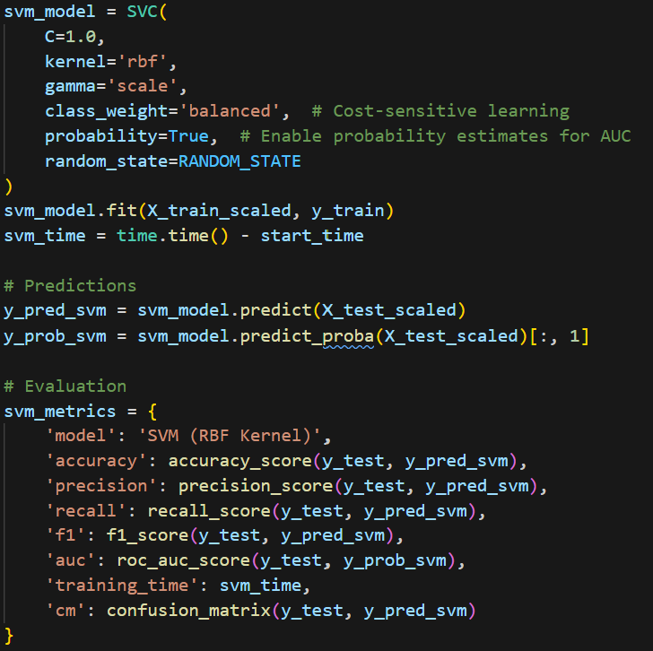
Support Vector Machine
Model 4: More models we tested. This model is also cost sensitive
Accuracy: 0.7528
Precision: 0.4556
Recall: 0.6036
F1-Score: 0.5193
AUC (Area Under the ROC Curve): 0.7576
Missed Defaults (FN): 526
False Alarms (FP): 957
Caught Defaults (TP): 801
True Negatives (TN): 3716
Notes:
Ashu

Slide 22

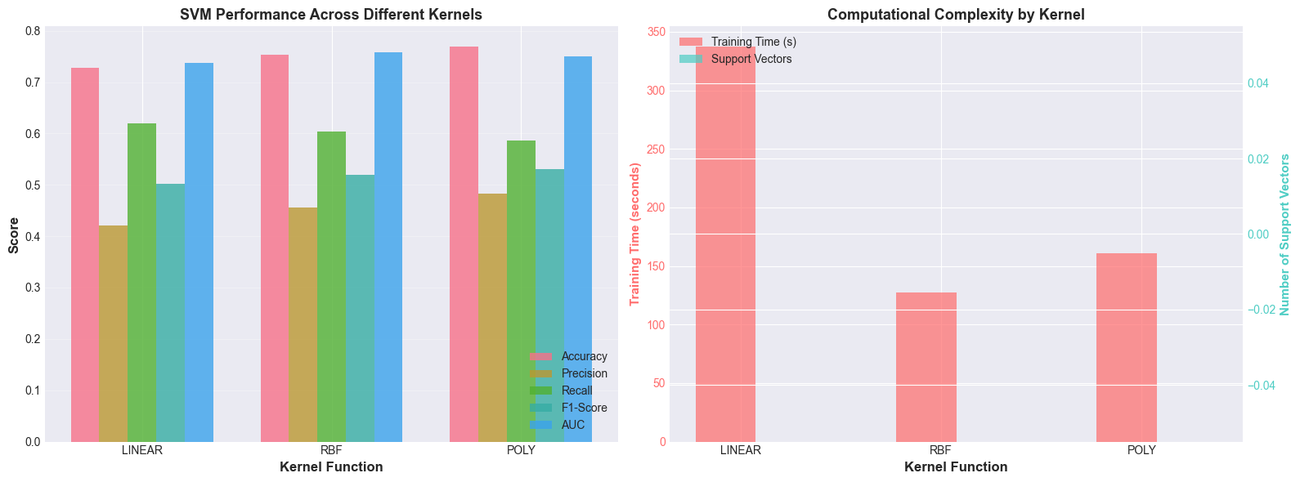
Kernel Functions Demonstration (SVM)
Kernel Functions Demo (on SVM)
We used Support Vector Machines to show comparing different kernel functions:
- Linear Kernel: For linearly separable data
Radial Basis Function Kernel: For non-linear patterns
Polynomial Kernel: For polynomial decision boundaries
Our Insights
We found that
Linear: Slowest training
RBF: Most flexible, fastest
Polynomial: Medium speed, highest f-1 score
Notes:
Ashu

Slide 23
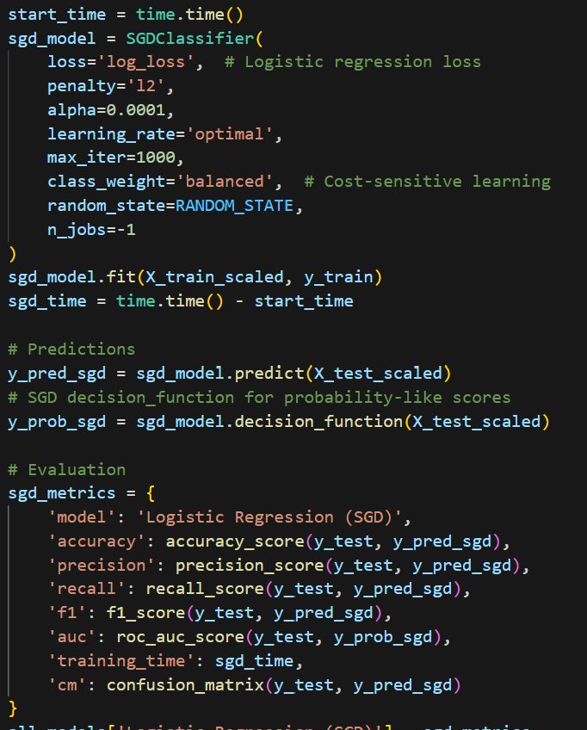
Logistic Regression (with SGD)
Model 5: We pefromed logistic regression with a SGD optimizer.
Accuracy: 0.7193
Precision: 0.4126
Recall: 0.6353
F1-Score: 0.5003
AUC (Area Under the ROC Curve): 0.7360
Missed Defaults (FN): 484
False Alarms (FP): 1200
Caught Defaults (TP): 843
True Negatives (TN): 3473
Notes:
Ashu

Slide 24
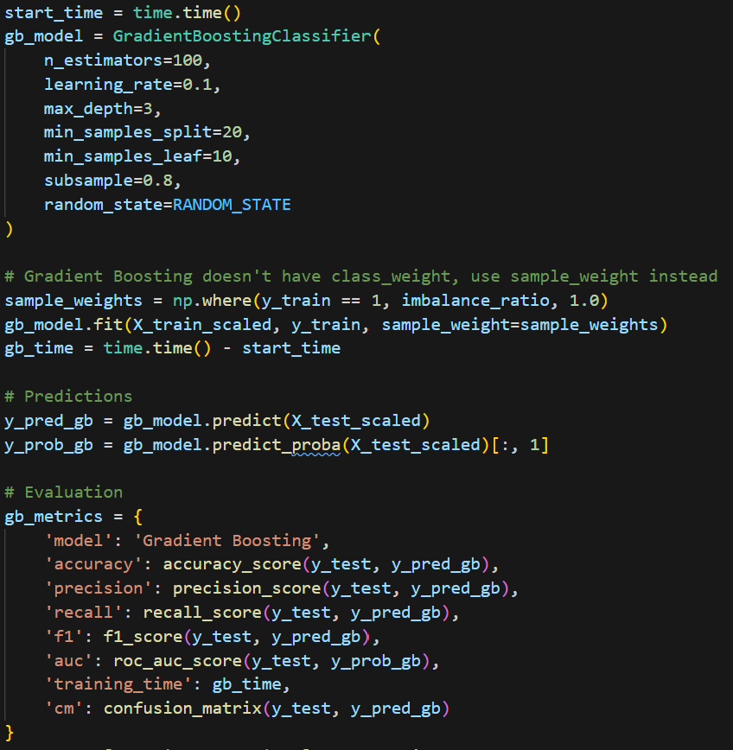
Gradient Boosting – We can skip
Model 6: The out of the box version of Gadient Boosting provided by sklearn
Accuracy: 0.7508
Precision: 0.4546
Recall: 0.6338
F1-Score: 0.5294
AUC (Area Under the ROC Curve): 0.7811
Missed Defaults (FN): 486
False Alarms (FP): 1009
Caught Defaults (TP): 841
True Negatives (TN): 3664
Notes:
Ashu?

Slide 25

Other Analysis

Slide 26
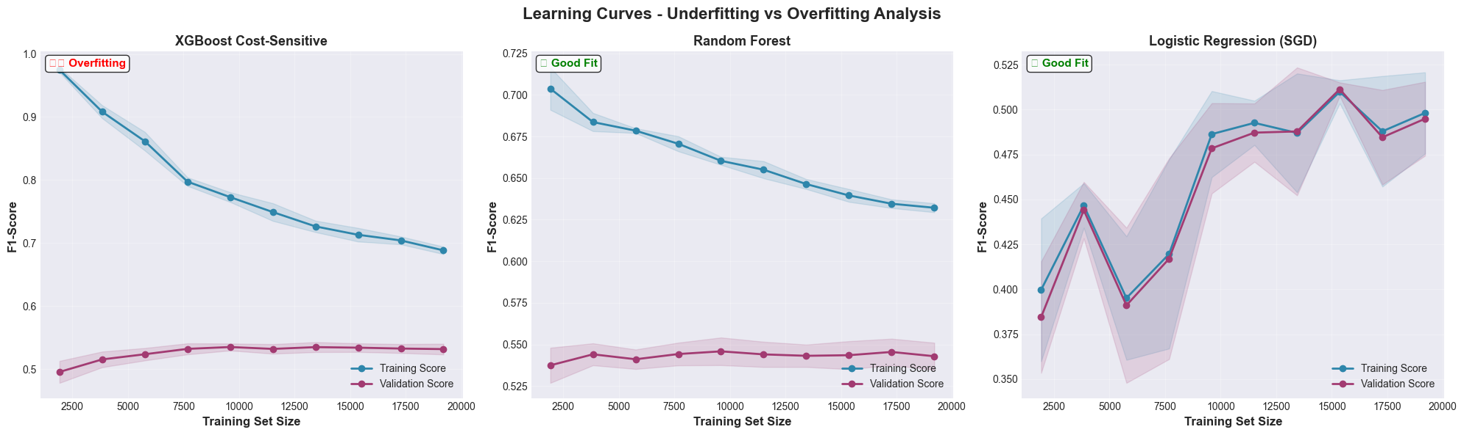
Kernel Functions Demonstration (SVM)
Learning Curves Analysis
We can use learning curves to detect underfitting and overfitting by showing how well the training and validation scores change with training size.
Small train-validation gap shows good generalization (low overfitting)
Converging curves show Model has learned effectively
Large gap shows overfitting (model memorizes training data)
Low scores for both show underfitting (model too simple)
Our Insights
Therefore, we can conclude that:
XGBoost Cost-Sensitive it’s overfitting
Logistic Regression/SGD good fit

Slide 27
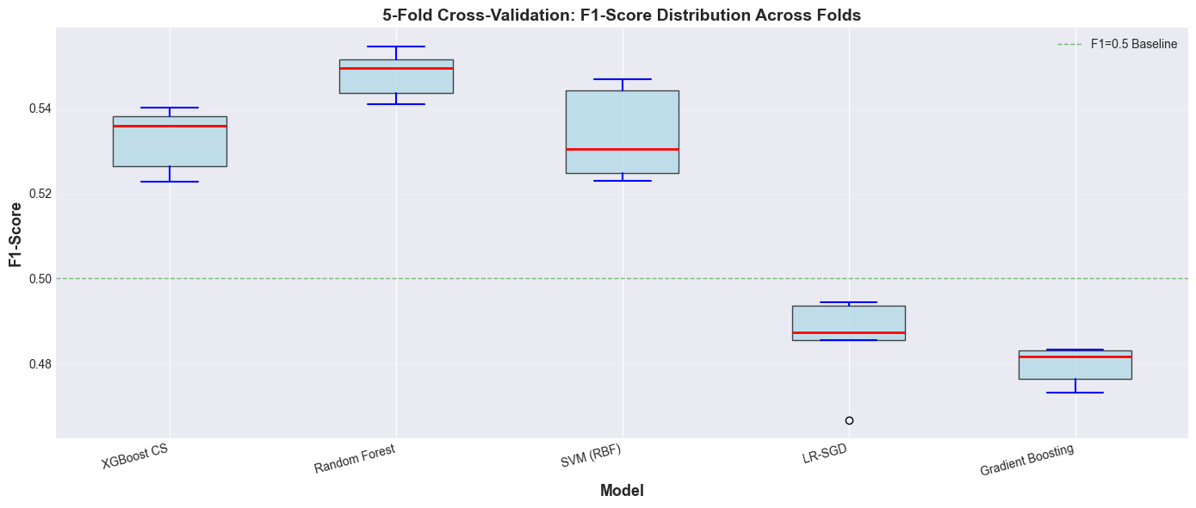
Kernel Functions Demonstration (SVM)
K-Fold Cross-Validation
This validation provides performance estimates across different training and validation data splits
The 22.12% default rate was maintained
Reduced variance in evaluation
Low standard deviation shows stable, consistent performance
High standard deviation shows model sensitive to data splits
CV scores validate test set results (no lucky splits)
Our Insights
Therefore, we can conclude that:
- SVM is least stable and sensitive to data split
- Random forest sill best
- Logistic Regression seems most stable

Slide 28

Final Comparison & Our Choice
Final Findings
This Photo by Unknown Author is licensed under CC BY-NC-ND

Slide 29
Final Comparison & Our Choice
Grand Comparison
Model | Accuracy | Precision | Recall | F1-Score | AUC | Missed Defaults (FN) | False Alarms (FP) | Caught Defaults (TP) | True Negatives (TN)
Random Forest | 0.7758 | 0.4943 | 0.592 | 0.5389 | 0.78 | 541 | 804 | 786 | 3869
XGBoost Cost-Sensitive | 0.762 | 0.4715 | 0.629 | 0.5388 | 0.776 | 493 | 935 | 834 | 3738
Gradient Boosting | 0.7508 | 0.4546 | 0.634 | 0.5294 | 0.781 | 486 | 1009 | 841 | 3664
SVM | 0.7528 | 0.4556 | 0.604 | 0.5193 | 0.758 | 526 | 957 | 801 | 3716
Logistic Regression (SGD) | 0.7193 | 0.4126 | 0.635 | 0.5003 | 0.736 | 484 | 1200 | 843 | 3473
XGBoost Baseline | 0.8183 | 0.6591 | 0.37 | 0.4739 | 0.778 | 836 | 254 | 491 | 441
- Cost-sensitive models significantly improve recall (catch more defaults)
- Different models excel at different things
XGBoost was most accurate, but had high false negatives
Random forest does have higher F-1 score but has for false negatives
Findings
This Photo by Unknown Author is licensed under CC BY-NC-ND

Slide 30
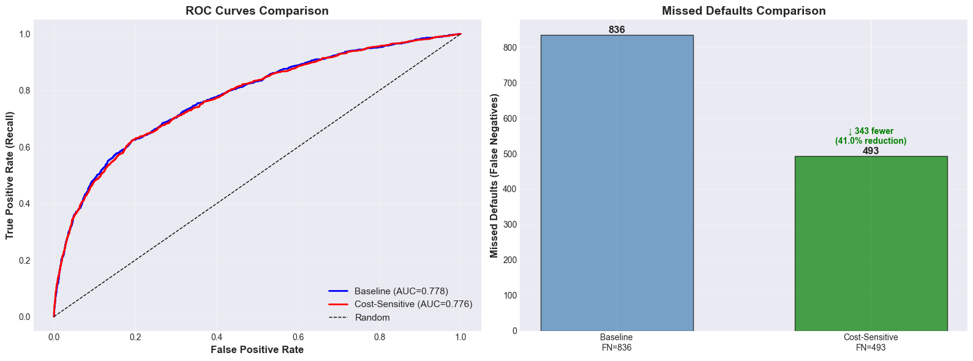
Final Comparison & Our Choice
Focus Just On XGBoost
Cost Analysis
Baseline Model:
Missed defaults cost:
836 × $10,000 = $8,360,000
False alarm cost:
254 × $200 = $50,800
Total Cost: $8,410,800
Cost-Sensitive Model:
Missed defaults cost:
493 × $10,000 = $4,930,000
False alarm cost:
935 × $200 = $187,000
Total Cost: $5,117,000
From the graphic above we can see both models show similar discrimination ability (close AUCs)
And cost sensitive has much less false positives!
More Alalyis
This Photo by Unknown Author is licensed under CC BY-NC-ND

Slide 31

Choice!
XGBoosted Cost Sensitive
This Photo by Unknown Author is licensed under CC BY-NC-ND
Notes:
These models perform well on large datasets.
Cost-sensitive model catches significantly more defaults
Achieves higher Recall and F1-Score despite lower accuracy
Estimated savings: $3M-$5M+ annually (based on experimental validation)
Trade-off: More false alarms acceptable when default cost >> false alarm cost
The best we can do

Slide 32

Future
Future
Limitations
1. Dataset Constraints
- 6 month Taiwan-specific data may not generalize globally
- Features: income, employment status, FICO scores are missing
2. Model Limitations
- No deep learning methods explored
- Threshold fixed at 0.5
3. Evaluation Scope
- Test set performance only (no temporal validation)
- Binary classification (no risk scoring tiers)
- Cost assumptions simplified ($10K/default, $200/false alarm)
Future
Explore more datasets with:
- International dataset with more features
- More demographic features
2. Explore deep learning, ensemble methods (stacking, blending). neural networks (LSTM for temporal patterns). explainable AI (SHAP values for interpretability), time series feature extraction

Slide 33

Thank You!

